Slide 1

"Sanwada" - Literature Review Presentation
Team Members :
100022U – Ahsan M.S.A.
100052K – Bandara B.M.C.K.
100366C – palihakkara S.
100466H – Sahabandu D.M.
Project Supervisor :
Dr. Surangika Ranathunga

Slide 2
Introduction

Slide 3
Problem
Getting a computer to understand a spontaneous dialogue precisely is still an open issue
Some of the characteristics of modelling a spontaneous dialogue have already been identified
e.g. ?
add Dtag recognition as one e.g .and higlight it
But not yet done for Sinhala
add a new slide for dtags (u can modify the next slide). describe what they are. then say it has not been done for sinhala
Notes:
Here I will briefly discuss the above noted point

Slide 4
What are Dialogue Acts
“A Dialogue Act represents the meaning of an utterance at the level of illocutionary force”[1]
-Austin (1962)-
[1] Austin, J. L. 1962. How to do Things with Words. Clarendon Press, Oxford.
Notes:
Here I will explain what are dialogue acts in simple words

Slide 5
Our Aim
To make use of the already existing research for Dialog Act Recognition for English and explore how it can be used in the context of Sinhala.
Notes:
Here I’ll discuss the relationship between the two languages. (The language families)

Slide 6
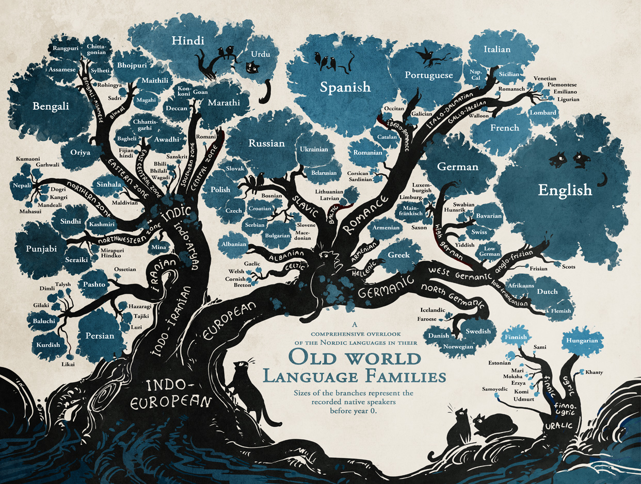

Slide 7
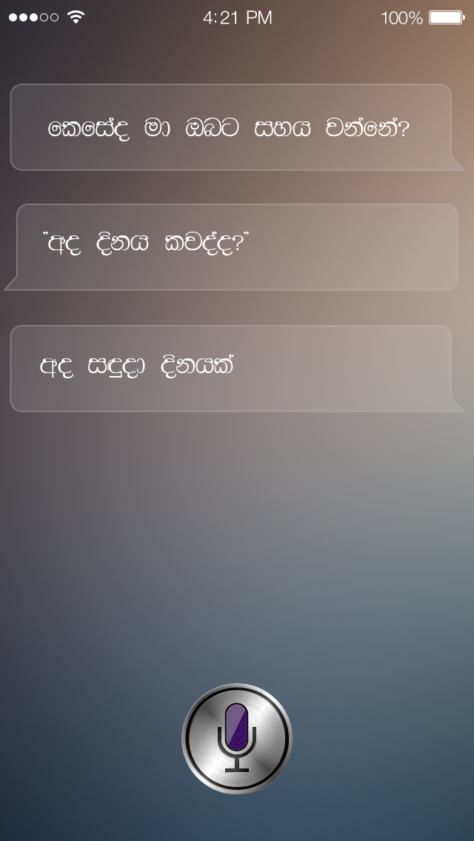
Why is it important?
Meeting Summarization
Question-Answering systems
Automated Assistance
Notes:
To understand a spontaneous dialogue, it is important to model and automatically identify the structure of that dialogue, because it will make it easier to get a better interpretation of that spontaneous dialogue. How to model a spontaneous dialogue precisely is still an open issue, though some of the specific characteristics for modelling a spontaneous dialogue have already been identified. Among these clearly identified characteristics, Dialogue Acts hold an important place.

Slide 8
Steps
Corpus Building
Selection of Dialogue Act Tag Set
Feature Selection
Classifier Selection
optional step of analysing results
Notes:
Briefly go through these step.

Slide 9
"Sanwada" Corpus

Slide 10
Existing Corpora
SWITCHBOARD
VERBMOBIL
ICSI Meeting Recorder
Map Task
Notes:
I’ll briefly describe the above mentioned corpora

Slide 11
Our approach to build “Sanawada” Corpus
Translate an Existing Standard English Corpus
Sinhala Chat Tool
Sinhala subtitles of English movies
- 1.8 Million untagged utterances
- 12000 Tagged utterances
Notes:
I will discuss these steps and our final resultant corpus and handover the presentation to chamika.

Slide 12
Identifying Tag Set

Slide 13
Identification Rules – Tag Set
Three requirements[1] for tag set selection
The DA tags should be generic enough to be useful for different tasks, or at least robust to the unpredictable variability and evolution of the target application.
The DA tags must be specific enough to encode detailed and exploitable characteristics of the target task.
The DA tags must be clear and easily separable, in order to maximize the agreement between human labelers.
[1] Král, P., & Cerisara, C. (2012). Dialogue act recognition approaches.Computing and Informatics, 29(2), 227-250.
Notes:
say this can b applied to any language or context

Slide 14
Dialogue Act Markup in Several Layers (DAMSL)[1] tag set.
Provides a domain-independent universal framework for dialogue annotation
[1] Allen, J., & Core, M. (1997). Draft of DAMSL: Dialog act markup in several layers. Unpublished manuscript, 2.

Slide 15
Tag Sets in the Literature
Dialogue Act Markup in Several Layers (DAMSL) - [220 tags - Conversational dialogue type ]
The Switchboard SWBD-DAMSL [220 tag elements -> 42 tag classes-Conversational dialogue type ]
The Meeting Recorder [50 tags - Task Oriented dialogue type]
The VERBMOBIL [46 tags - Task Oriented dialogue type]
The Map-Task [12 tags - Task Oriented dialogue type]
Notes:
Adaptability for Existing Tag sets.
For almost all the research purposes, people have used combinations and subsets of the above mentioned tag sets

Slide 16
Tag set size
To determine the size of the tag set, it is important to consider several facts.
Size of the corpus
Context of the task/application
Language native characteristics
Notes:
If we consider the Sinhala language, although there are very few similarities between Sinhala and English we can consider it as a different language with a different set of language characteristics. For example, in English it is an easy task to categorize the utterances into the categories, commands, orders and requests, because there is significant difference between command utterances, order utterances and request utterances. For example, in a request utterance the word “please” is commonly used while in an order it is rarely used. But with the native language characteristics of Sinhala it is hard task to find the separation between these three categories. With the prosodic information it might be possible, but only with the lexical and syntactical information of the utterances, task is almost impossible. So the best thing to do is combine these three categories into a single dialogue act and use it.

Slide 17
Tag Set Selection - Experiments

Slide 18
Horizontal tag set analysis of popular research papers relevant to the context
Dialogue act modeling for automatic tagging and recognition of conversational speech [ Andreas Stockle-2000]
Classifying Dialogue Acts in One-on-One Live Chats[Su Nam Kim-2000]
Dialogue Act Classification Based on Intra-Utterance Features[Nick Webb-2000] - SWITCHBOARD Dialogue Acts(42 tag Classes)
Automatic Instant Messaging Dialog using statistical model and dialog acts- [Edward Ivonic-2008]
Text Based Dialogue Act Classification for Multiparty Meetings. [Matthias Shirberg - 2006]
Lexical and Discourse Analysis of Online Chat Dialog - [Eric N. Forsyth and Craig H. Martell- 2007 ]
Combinations of Classifiers for Automatic Recognition of Dialogue acts[ Pavel Kral-2005]
Lexical, Prosodic, and Syntactic Cues for Dialogue Acts [ Daniel Jurafsky - 1997

Slide 19
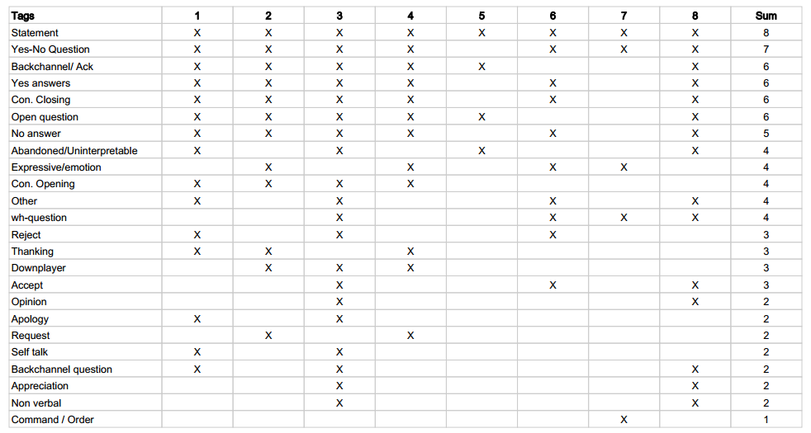
Horizontal Analysis
Notes:
24

Slide 20
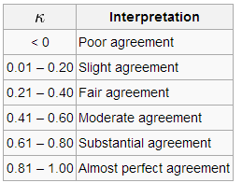
Kappa Value
It is a statistical measure of inter-rater agreement or inter-annotator agreement for qualitative (categorical) items.
Kappa Value
Cohen's kappa
Fleiss' kappa

Slide 21
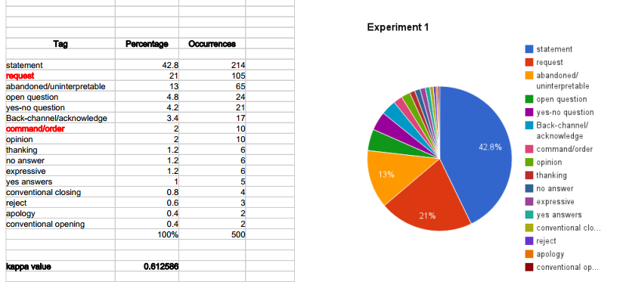
Experiment 1

Slide 22
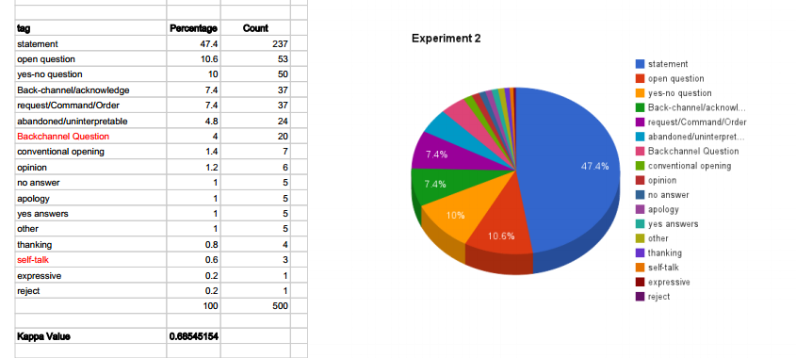
Experiment 2

Slide 23
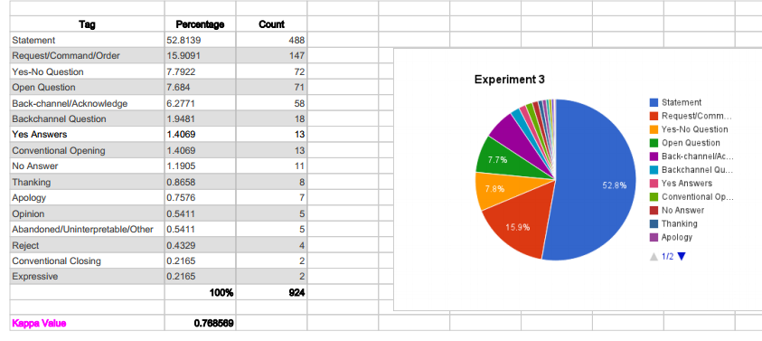
Experiment 3

Slide 24
Finalized Tag Set for “Sanwada” Corpus
Statement
Request/Command/Order
Yes-No Question
Open Question
Back-channel/Acknowledge
Backchannel Question
Yes Answers
Conventional Opening
No Answer
Thanking
Apology
Opinion
Abandoned/Uninterpretable/Other
Reject
Conventional Closing
Expressive

Slide 25
Feature Selection

Slide 26
What is a Feature?
Features are the input given for the classifier as a vector for each word in the utterance. each word
Can be extracted from the utterances
Heavily depends on the language

Slide 27
4 major categories of features[1]
Time Related Features
Word Related Features
Prosodic Features
Online Features
[1] Hop den Akker, H., & Schulz, C. (2008). Exploring features and classifiers for dialogue act segmentation.
In Machine Learning for Multimodal Interaction (pp. 196-207). Springer Berlin Heidelberg.
Notes:
Pause between two words, Duration of the word, Mean duration of the word and Relative duration
Current word, next word and previous word , POS Current word, Word Repeat
Pitch Features and Energy Features
Number of words in previous segment , Distance to the last segment , elative position of word inside the segment ,

Slide 28
Selected features for Sinhala
Feature | Status
Number of words in the segment | Selected
Bigrams/Trigrams of words | Selected
Previous Dialogue Act | Selected
Verb of the Sentence | Selected
Punctuation marks | Selected
Grammar pattern | Selected
Frequent words for each tag | Selected
First two words | Not-selected
Last two words | Not-selected
First verb type/ Second verb type | Not-selected
Words in last 10 Dialogue Acts | Not-selected
N-grams of previous Dialogue Acts | Not-selected
Bag-of–words | Not-selected
Unigrams | Not-selected
Notes:
since we are using the Bigrams as a feature, feature first two words and last two words were omitted.
First verb type and Second verb type is omitted due to the unavailability of Sinhala PoS tagger.
Taking previous Dialogue Acts as features can introduce a cumulative error
Unigrams are ineffective for long utterance, although their effectiveness has been shown for chat messages

Slide 29
Exclusive features for Sinhala
Last letter of the last word of the utterance
last word of an utterance
The presence of specific Sinhala cue phrases
Sinhala cue phrase(s) | English cue phrase
ඇත්තෙන්ම | actually
සහ, හා | and
නිසා, හින්ද | because
එසේම | also
එහෙත්, නමුත් | but
වගේ, වැනි, වාගේ | like
ඉතින්, එවිට | then
හෝ | or
හරි | well
එනිසා, එබැවින් | so
Notes:
Unlike in English, the last letter of the utterance makes a big impact on the dialogue act of the utterance. For instance most of the Yes/No questions ends with the letter ‘ද’(da), most of Request/Command/Order ends with one of the letters ‘න්’(n), ‘න’(na), or ‘ නු’(nu), most of Open questions end with ‘නේ’(ne).

Slide 30
Selecting useful features
The idea of the experiment is to identify the most contributing features for classifying and the most effective combinations of the features
Trained WEKA Classifier with a training set and tested with another set
Compared the infoGain values
Notes:
need to minimize the size because test with all combination is computationally expensive

Slide 31
InfoGain value
The InfoGain value evaluates the worth of a feature by measuring the information gain resulted only by that particular feature
For example, a feature with an InfoGain value of 1 means that all of the information available in that feature contributes to classification
But it does not mean that the use of that feature alone is able to conduct the entire classification

Slide 32
Individual Feature Performance
Rank | Feature | InfoGain
1 | Punctuation marks | 0.71
2 | Last word of the utterance | 0.60
3 | Frequent words for each tag | 0.42
4 | Trigrams/Bigrams | 0.31
5 | Last letter of the last word of the sentence | 0.30
6 | Verb of the Sentence | 0.24
7 | Number of words in the segment | 0.18
8 | Cue Phrases | 0.17

Slide 33
Problems
No PoS tagger tool for Sinhala
Improperly used punctuation marks
Various Grammar patterns of Sinhala
Notes:
as lack of resources for PoS tagging for Sinhala. Therefore we used a set of commonly used Sinhala verbs to check the presence of those verbs in a given utterance as feature.

Slide 34
Best Combination
Punctuation marks
Last word of the utterance
Trigrams/Bigrams
Last letter of the last word of the sentence
Frequent words for each tag
Cue Phrases

Slide 35
Classifier Selection
Notes:
So far we discuss about corpus , tag selection and feature selection. Let's discuss the classifier selection now. DA classification means assigning DA types to individual utterances. How these different DA types are defined depends on many factors such as goal of the application, size of the corpus and the experimental setup.

Slide 36
Information Sources for Classifiers
Linguistic Information
- Lexical and Collocation information
- e.g: uh-huh, do you
Contextual Information
-dialogue context, structure, global context
- e.g: Hello, Have a nice day,
- Welcome & How may I help you?
Perceptual Information
- Acoustic, prosodic and visual information
- e.g: pitch, pause, energy, speaking rate
Notes:
different DAs use distinctive word strings. cue words and phrases can serve as explicit indicators for classifiers to do classification. Similarly, For example, 92.4% of the uh-huh’s occur in BACKCHANNELS, and 88.4% of the trigrams “<start>do you” occur in YES-NO-QUESTIONS.
An utterance such as “Hello” will occur at the beginning ,“Have a nice day” will typically appear at the end.the greeting “Welcome” and question “How may I help you?” could occur in the same turn.
some utterances are inherently ambiguous based on words alone. For example, some Yes-No-Questions have word sequences identical to those of statements, but can often be distinguished by their prosodic information.

Slide 37
Popular Classification Models
N-gram Model
contiguous sequence of n items(e.g bigram)
current DA type is determined by some No. of(K) preceding DAs.
Hidden Markov Models
Represent probability over sequences of observations
Limited Horizon, Time invariant assumption
Forward-backward, Viterbi algorithm
cite the papers
Notes:
The sentence “This is our literature review”, for instance, contains five unigrams: “This”, “is”, “our”, “literature”, and “review”.

Slide 38
Naive Bayes
Based on Bayesian theorem
assumes that the value of a particular feature is unrelated to the presence or absence of any other feature
Neural Network
Multilayer structure of information processing
input weights adjusted dynamically according to a learning rate until it reaches close enough to the target output
Bayesian Network
Dependencies are specified by a directed acyclic graph
probability of an event is the degree of belief in that event

Slide 39
Classifiers We used
Statistical & Probabilistic
- Naive Bayes, Logistic, Simple Logistic
Decision tree
- J48, REPTree, LMT, Random Forest, Hoeffding Tree,
Decisionstump
Support Vector Machines
- Sequential minimal optimization
Rule Based
- Decision Tables

Slide 40
Classification process
8000 training utterances to train a classifier
4000 utterances for testing
Tested on different combination of feature sets
Started with J48 classifier and tested on 11 different classifiers
Used Weka Java library for implementing classification - what dd u implement? highlight

Slide 41
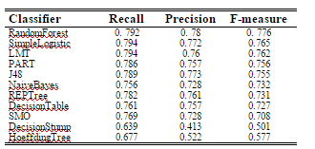
CLASSIFICATION ACCURACY
Simple Logistic and LMT classifiers give the highest recall value
They have identified more correctly tagged utterances compared to others
u should calculate an accuracy value as well

Slide 42
Performance Measures
Precision = {Relevant D’s} ᴖ {Retrieve D’s}
{Retrieve Documents}
Recall = {Relevant D’s} ᴖ {Retrieve D’s}
{Relevant Documents}
F-Measure = 2 X (precision x recall)
precision + recall
- combine both measurements

Slide 43
discuss what is yet to be done
mention the paper u plan to submit to NAACL and our conference as well

Slide 44
Q & A

Slide 45
Thank You!

